Slide 1
Cell Biology: Mesenchymal Stem Cell (MSC) Heterogeneity
Report Writing Workshop
BIO00066I: Becoming a Bioscientist 4: Research in Action
Dr Amanda Barnes and Dr Dan Jeffares
Check in: xxxxxx

Slide 2
Learning Outcomes for today’s session
Understand the scientific report assessment
Understand the background and context to the Cell Biology research project
Understand how the outputs from practical and data workshops form the basis of your scientific report
Notes:
Overview of the research process - have a look at the information given in 17C/8C/skills hub for introduction
Your skills journey and how it fits in with your final year projects and career - discuss the reflection at this point

Slide 3
How will I be assessed in this module?
2 Individual assessments (20 credit module, 200 hours)
The research outputs from laboratory practicals and data analysis workshops will be combined into a single research report assessed through:
2500 word Scientific report (80%)
RStudio project on report data analysis (20%)
Deadline for all assessment components: Thursday Week 11 (7th May at midday)

Slide 4
How will I be assessed in this module?
2500 word scientific report written individually, that uses the research outputs from laboratory practicals and data analysis workshops to address the research question
Title
Abstract
Introduction
Approach (justification of methods rather than a methods section)
Results
Discussion
References (Harvard referencing style)
No methods section is needed, results and discussion should not be combined into one section

Slide 5

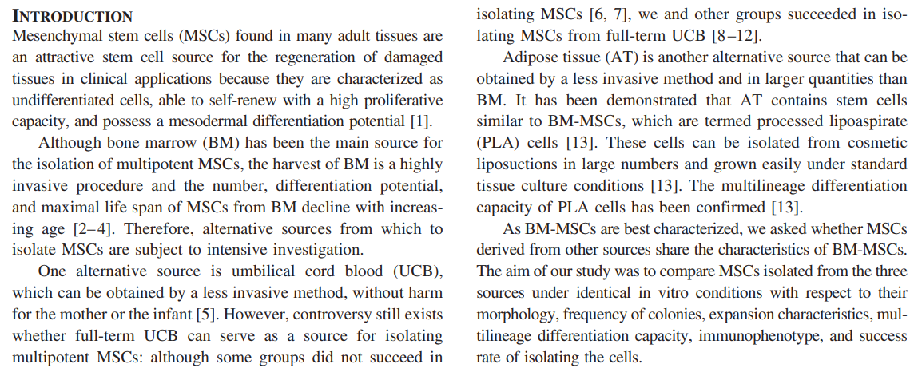
Exercise 1: How is an introduction structured?
Read through the introduction and analyse the structure. What is the purpose of the different paragraphs? Digital copy of Introduction, Direct Link to Paper

Slide 6
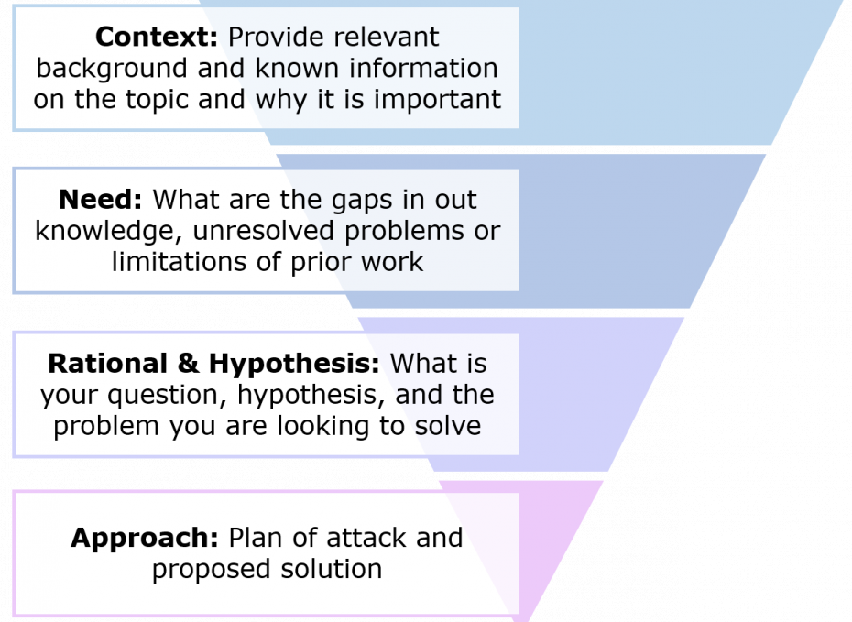
Exercise 1: How is an introduction structured?
The module began with an introduction giving background information on the subject area to help you understand where this project fits - your report introduction needs to do that as well to help the reader understand why you are doing the research and why it’s important! It should follow a funnel structure beginning broad and narrow to the research aim.
These should be supported by primary literature (research articles not review papers and should be the original source rather than another article which describes the work). Initial work from MSCs was 1960s onwards, but newer papers should be also be included to show current knowledge.
In this report you are asked to write a separate ‘Approach’ section to justify the experimental plan.

Slide 7
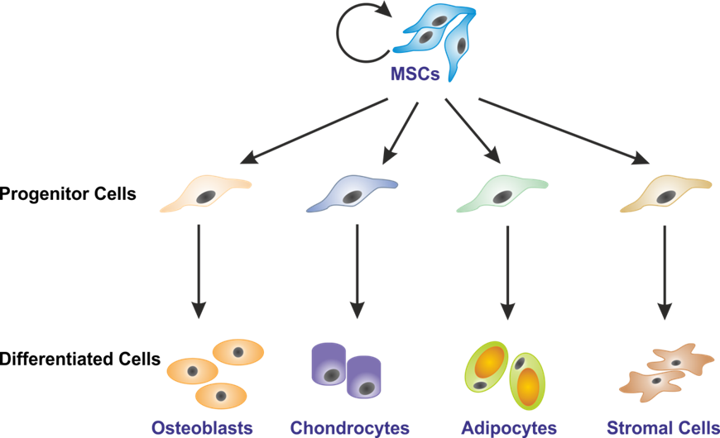
Our Research Area: MSCs vary in their potential to differentiate
Not all Mesenchymal stem cells (MSCs) are the same. They are a mixed population (heterogenous) of cells ranging from tripotent to nullipotent
For use therapeutically it could be beneficial to isolate a subpopulation of MSCs that have specific characteristics. E.g. Osteogenic cells for bone repair
Clonal lines (lines of cells derived from a single stem cell) are used to investigate the properties of subpopulations
Tripotent - cells that can differentiate into bone (osteogenesis), cartilage (chondrogenesis) and fat (adipogenesis) cells
Nullipotent - cells that can’t differentiate

Slide 8
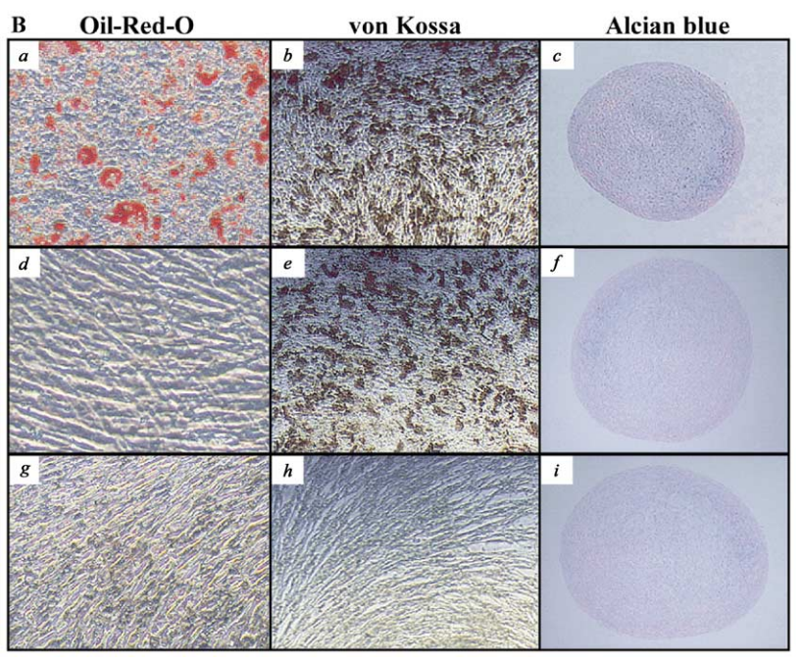
MSCs vary in their potential to differentiate
Specific stains are used to confirm if MSCs can differentiate. Subpopulations that were differentiated (left) vary in AOC potency. One subpopulation is tripotent (a,b,c) and another is nullipotent (g,h,i)
Analysis of cell surface markers is currently used to confirm if an isolated population of cells from bone marrow or fat are MSCs. But these markers are on all cells in an MSC population and don’t distinguish between subpopulations (Cytotherapy, 8 (2006), pp. 315-317)
Tripotent MSC subpopulation
Nullipotent MSC subpopulation
Adipogenesis (A)
Osteogenesis (O)
Chondrogenesis (C)
Biochem. and Biophys. Res. Comms. 295 (2002) 354–361

Slide 9
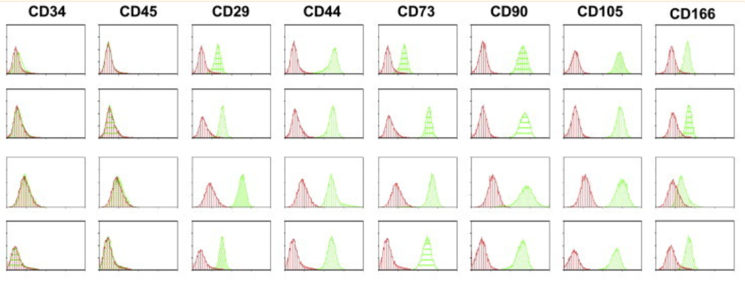
MSC subpopulations cannot be identified using cell surface markers
Flow cytometry of four different hMSC subpopulations which differ in their ability to differentiate. They have very similar profiles for cell surface markers (CD29, CD44, CD73, CD90, CD105 and CD166, negative for CD34 and CD45) even though they are functionally different.

Slide 10

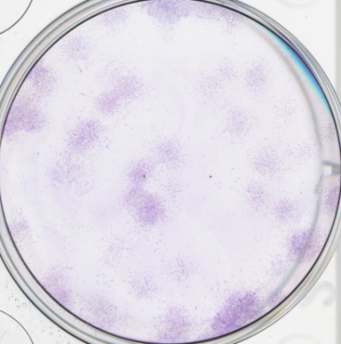
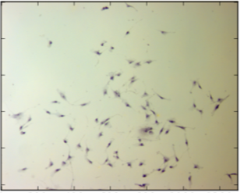
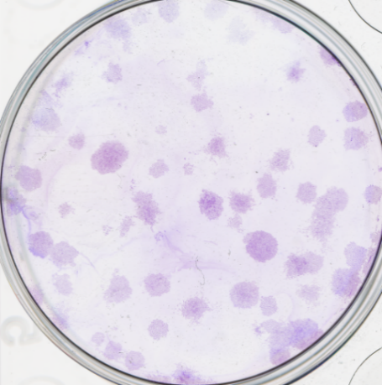
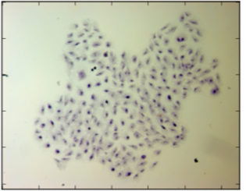
MSC clones vary in their shape and movement
Crystal Violet Stain
Dispersed
Fibroblastoid
Clone A
Compact
Large, spread
Clone B
Research Question: Can cell shape and movement predict the capacity of an MSC to differentiate? (essentially, do subpopulations that have different abilities to differentiate also differ in their cell shapes and the way they move?)
Notes:
In-vitro analysis of MSC migration of clonal lines appears to show variation in cell shape and migration - could this be a useful property to identify MSC subtypes if it correlated with stem cell potency?

Slide 11
Exercise 2: What experimental approaches are we using to address the research question?
Experimental Aim
To assess whether subpopulations of hMSCs that may differ in differentiation potential, also have differences in morphology (cell shape and size) and migration (e.g. speed and distance travelled).
How did you/ are you investigating the aim?
Discuss this in groups to help you consider how you’ll write the Approach section of your reports.
Report Guidelines
Example Approach Section, Direct link to example paper

Slide 12
Exercise 3: How do I write the results section
Discuss in groups the following:
What is the purpose of a results section in a scientific report and what should it contain?
What specific data will contribute to your report?
What type of plots and images do you think this section should contain?

Slide 13
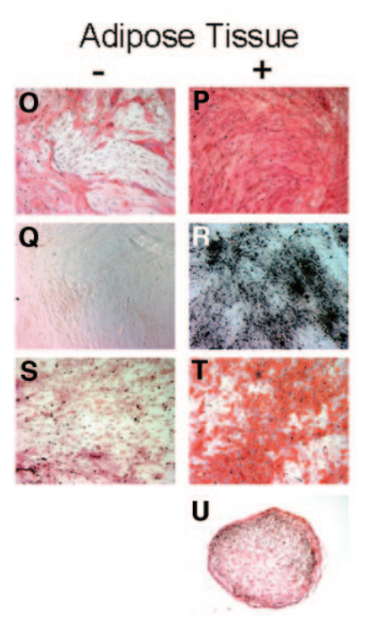
Exercise 4: Understanding figures and discussion elements
Discuss in groups the following:
What is the purpose of the discussion section in a scientific report?
Look at the figure. What is good and bad about it? What conclusions can you draw from the data?
Digital copy of Figure
3. Given the conclusions what further experiment would you suggest?
Figure 2. Multilineage differentiation capacity of adipose derived mesenchymal stem cells. Alkaline phosphatase activity (P), noninduced controls (O), deposition of a mineralized matrix: von Kossa stain (R), noninduced control (Q), Oil Red O stain (T), noninduced control (S). Safranin O staining in cryosections (U).

Slide 14
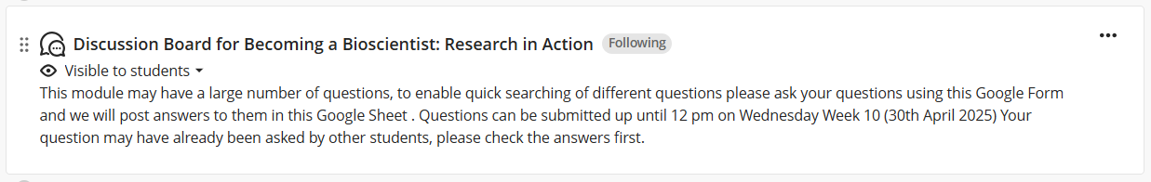
How can I ask questions?
In teaching sessions and tutorials, we are all happy to help :)
Through the online discussion board (for help with RStudio code it is very helpful if you copy and paste the part of the code you have a question about with your question)
Module Q&A sessions
In fairness to all students we won’t provide support via email, please use the discussion board instead
Scientific Writing - Skills Hub

Slide 15
Learning Outcomes for today’s session
Understand the scientific report assessment
Understand the background and context to the Cell Biology research project
Understand how the outputs from practical and data workshops form the basis of your scientific report
Notes:
Overview of the research process - have a look at the information given in 17C/8C/skills hub for introduction
Your skills journey and how it fits in with your final year projects and career - discuss the reflection at this point

